Slide 1
An introduction into Rest Assured & WireMock
By rick van osch & loek ehren

Slide 2
Contents
Problems testing REST API’s
What is WireMock?
What is Rest Assured?
Demos
Exercises
Discussion
Questions

Slide 3
Problems testing REST APIs
Systems consisting out of multiple components
Not always available for testing
No control over test data

Slide 4
What is WireMock?
Simulator for HTTP-based APIs
Used within Java application, JUnit test, Servlet container or as standalone process.
Open source
http://wiremock.org

Slide 5
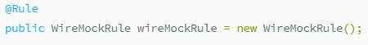


What is WireMock?
In Java(Using JUnit):
In Java(Without JUnit):
Standalone:

Slide 6
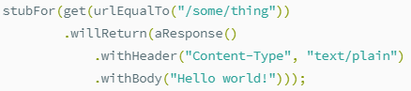
What is WireMock?
Mocking responses in code…
Fluent Interface
Simple

Slide 7
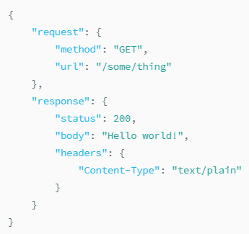
What is WireMock?
or JSON files(at runtime)
POST to http://<host>:<port>/__admin/mappings or placed with a .json extension in src/test/resourcesmappings

Slide 8
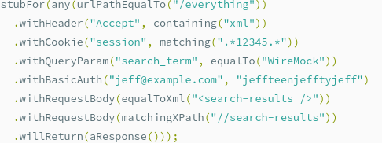
What is WireMock?

Slide 9
What is WireMock?
Stateful behaviour to mocks
More complex test cases

Slide 10
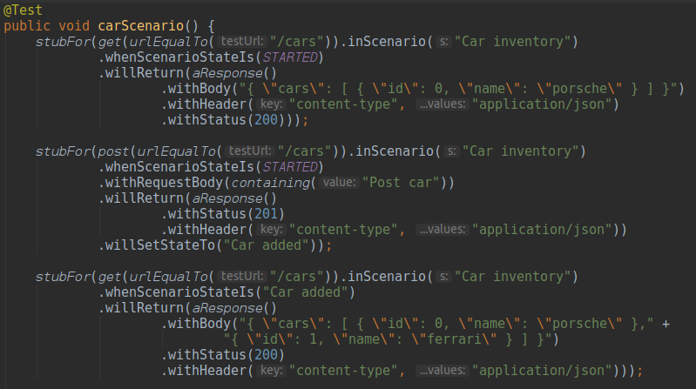
What is WireMock?

Slide 11
What is Rest Assured?
Java library for writing tests for REST APIs
Simple, fluent API
Easy to implement with other testing frameworks
Open Source
http://www.rest-assured.io

Slide 12
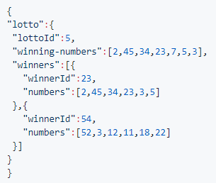
What is Rest Assured?
Assume response is:

Slide 13


What is Rest Assured?
Test with:
Uses org.hamcrest.Matchers
Supports JSONPath & XPath

Slide 14
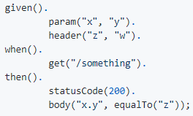
What is Rest Assured?
You can check statuscodes, headers, types, just like WireMock can mock them

Slide 15

What is Rest Assured?
Basic Authentication:
Also supports OAuth, Form Authentication and Custom Authentication

Slide 16
Exercises
git clone https://github.com/sebivenlo/WireMockRestAssured.git
cd into folder
cd 20_server/
docker build -t wsrs .
docker run -it -p 8080:8080 wsrs
Do exercises
Good luck have fun!

